Slide 1
Angry Prims Preliminary Proposal
Christian Williams
Francis Sabado
Aaron Mahmoud
University of Arkansas
25 Oct 2011
Notes:
This template can be used as a starter file to give updates for project milestones.
Sections
Right-click on a slide to add sections. Sections can help to organize your slides or facilitate collaboration between multiple authors.
Notes
Use the Notes section for delivery notes or to provide additional details for the audience. View these notes in Presentation View during your presentation.
Keep in mind the font size (important for accessibility, visibility, videotaping, and online production)
Coordinated colors
Pay particular attention to the graphs, charts, and text boxes.
Consider that attendees will print in black and white or grayscale. Run a test print to make sure your colors work when printed in pure black and white and grayscale.
Graphics, tables, and graphs
Keep it simple: If possible, use consistent, non-distracting styles and colors.
Label all graphs and tables.

Slide 2
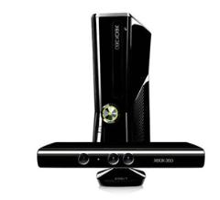
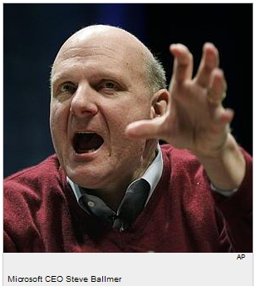
Project Overview
Kinect enabled games in a open world simulated environment.
Develop a game where the goal is to model a real world item using Kinect detected gestures.
Develop a 3D version of AngryBirds using SL as the game engine and Kinect as the control.
Notes:
What is the project about?
Define the goal of this project
Is it similar to projects in the past or is it a new effort?
Define the scope of this project
Is it an independent project or is it related to other projects?
* Note that this slide is not necessary for weekly status meetings

Slide 3
Current Status
Progress that has been made:
Communication between Kinect and SecondLife
Rudimentary gesture events written
The project currently ahead of schedule:
Need to develop the game sequence: Start, End, Restart
Notes:
* If any of these issues caused a schedule delay or need to be discussed further, include details in next slide.

Slide 4
Timeline
Design for games and plan of attack
Kinect Model Game Complete
Implantation of AngryPrims
Done
Capstone I
Completion
End Capstone II
Capstone II
Notes:
The following slides show several examples of timelines using SmartArt graphics.
Include a timeline for the project, clearly marking milestones, important dates, and highlight where the project is now.

Slide 5

Looking Ahead
Game Engine Implementation
Complex gestures and voice control
What are the expected deliverables?
Full Modeling game and source code then Full remake game and source code
Known risks and issues
Possible lag for some users
What are the immediate next steps?

Slide 6
Dependencies and Resources
Modeling and Angry Prims
Second Life
Kinect Client
SQL Database / Game object memory
PHP Server (Turing)
Remote Teams
Notes:
What are the dependencies that affect the timeline, cost, and output of this project?

Slide 7
Questions?

